Slide 1
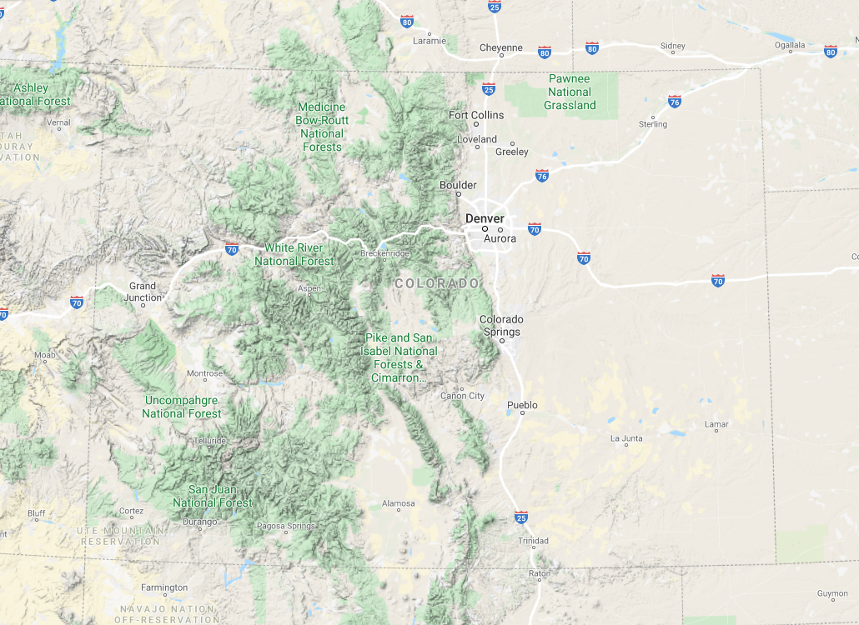
Walleyes were sampled during their spawning period in March 2019 at Narraguinnep Reservoir

Slide 2
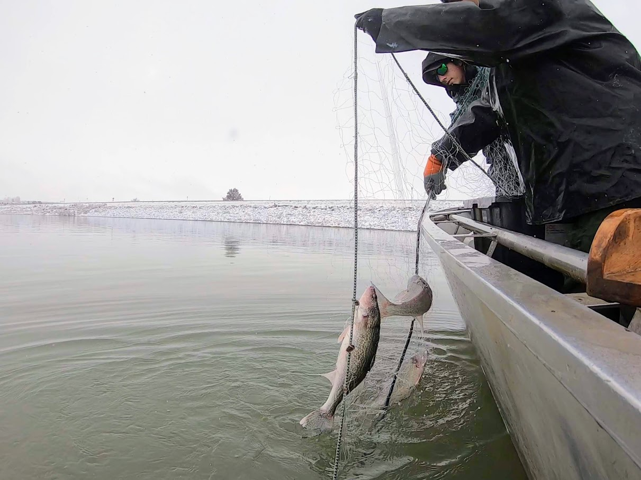
Multi-mesh gillnets were set in the evening at least 30 minutes prior to sunset and retrieved in the morning

Slide 3
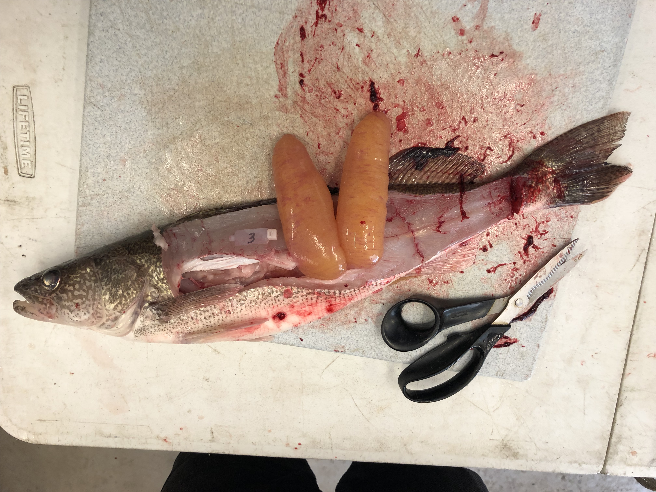
We recorded length, weight, sex, maturity status, and gonad weight for each Walleye
We collected muscle and gonad tissue samples, which were kept frozen until further analyses could be completed at the Fisheries Ecology Lab at CSU

Slide 4
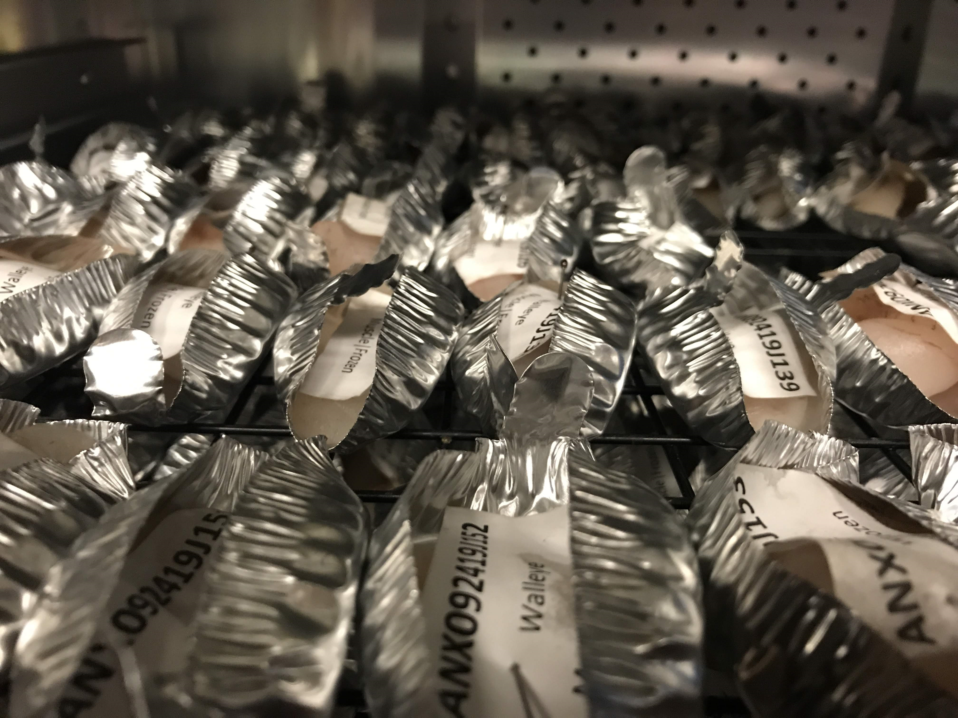
Upon arrival to the lab, gonads were dehydrated, weighed, and ground to a chalky consistency

Slide 5
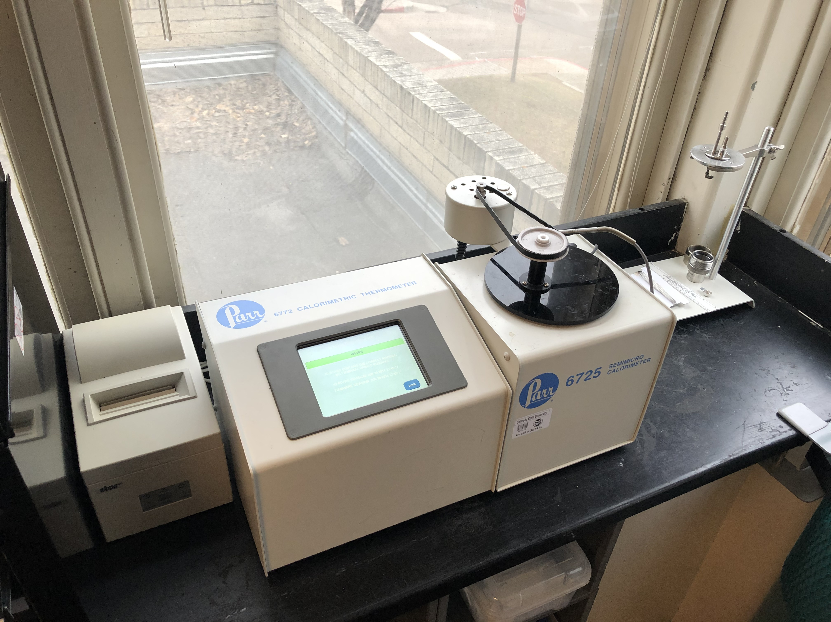
We used a Parr 1261 Isoperibol Bomb Calorimeter to measure the energy density of 3 replicate subsamples of dried gonad tissue from each female Walleye

Slide 6
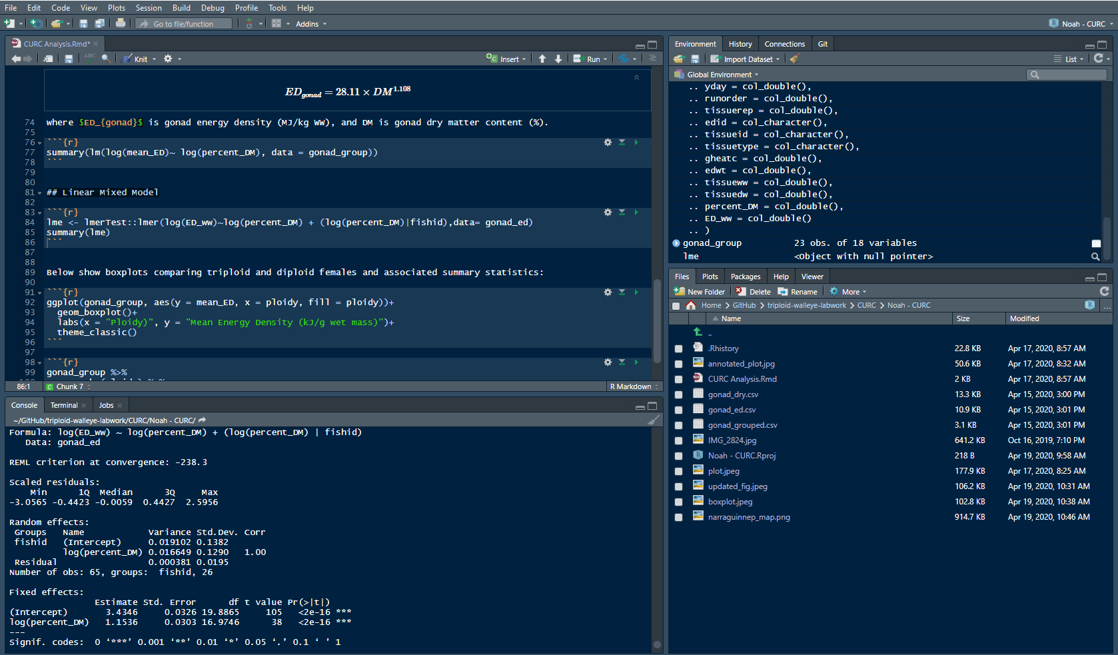
We used a linear mixed-effects model to test the relationship between percent dry matter and energy density using the package lme4 in R

Slide 7
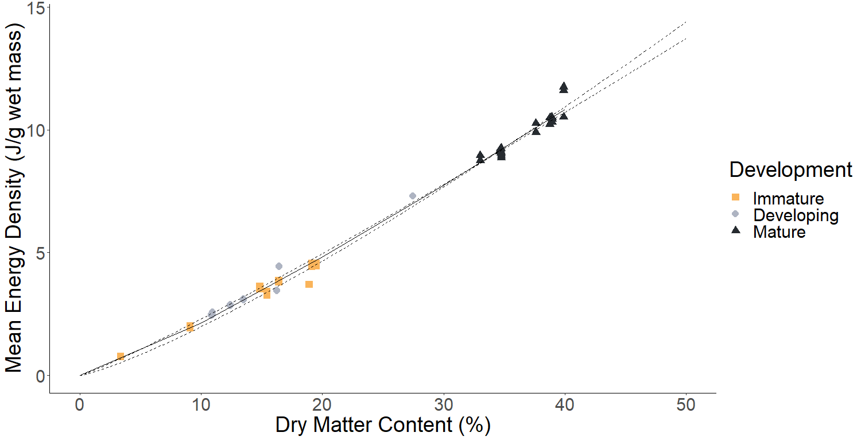
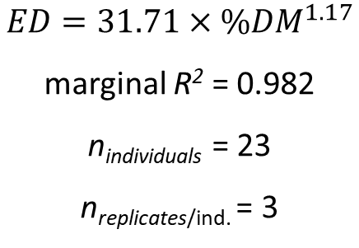
$$ED=31.71×{\%DM}^{1.17}$$
marginal R² = 0.982
n_{individuals} = 23
n_{replicates/ind.} = 3
Dashed lines show 95% confidence interval

Slide 8
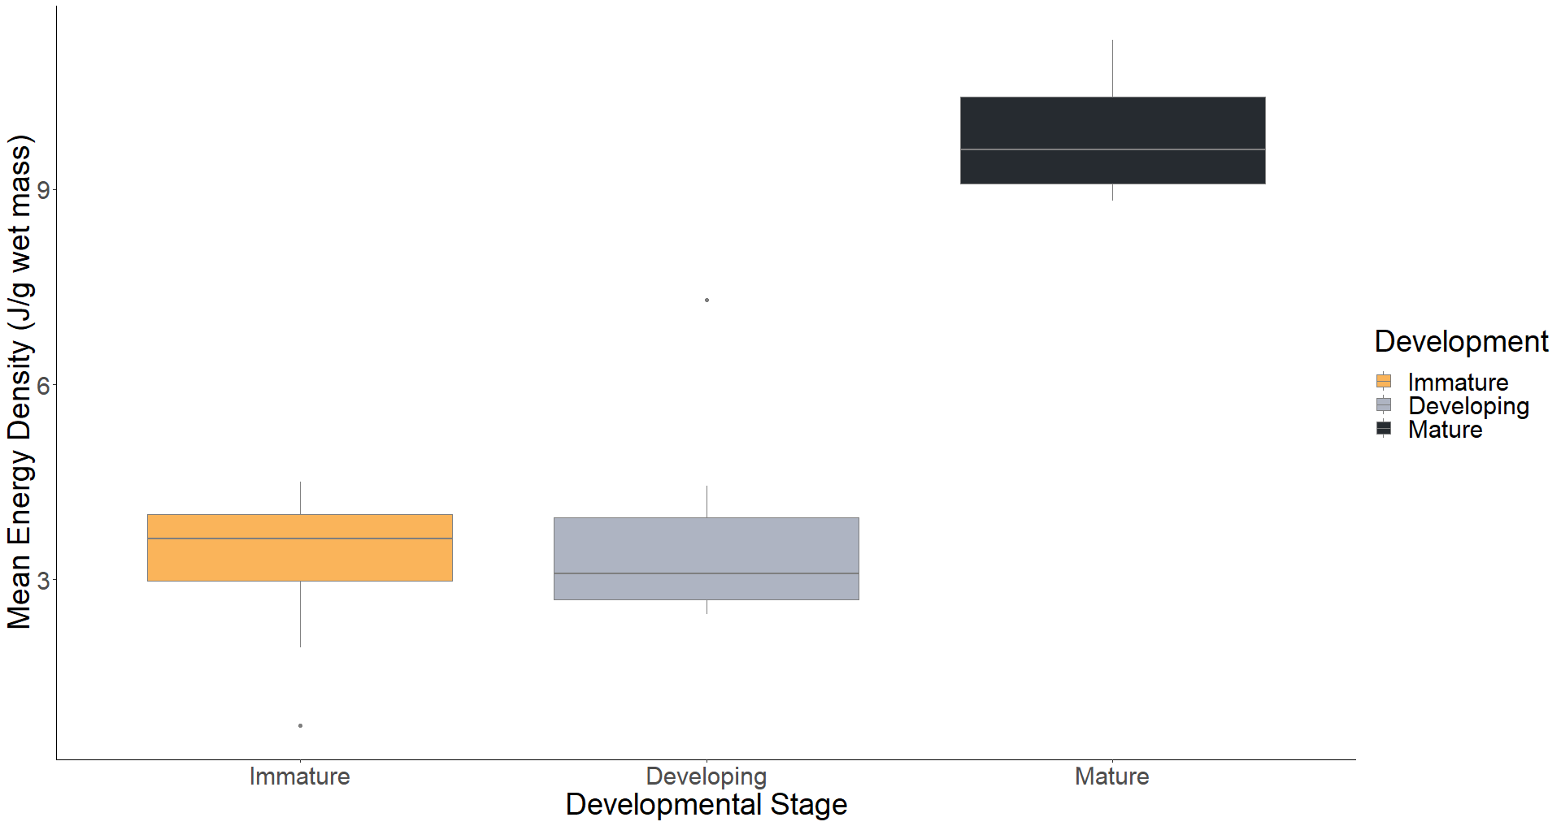
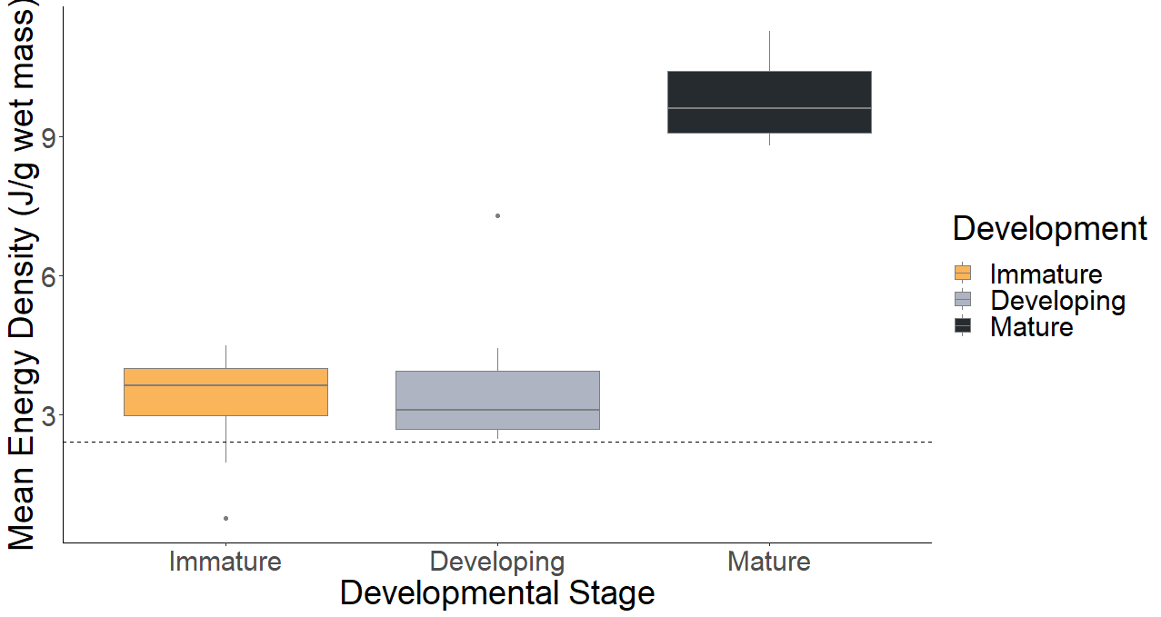
mean = 9.87 J/g
mean = 3.27 J/g
mean = 3.73 J/g
mean = 2.41 J/g
Dashed line is the average estimated whole body energy of a mature female Walleye (C.J. Farrell, unpublished)

Slide 9
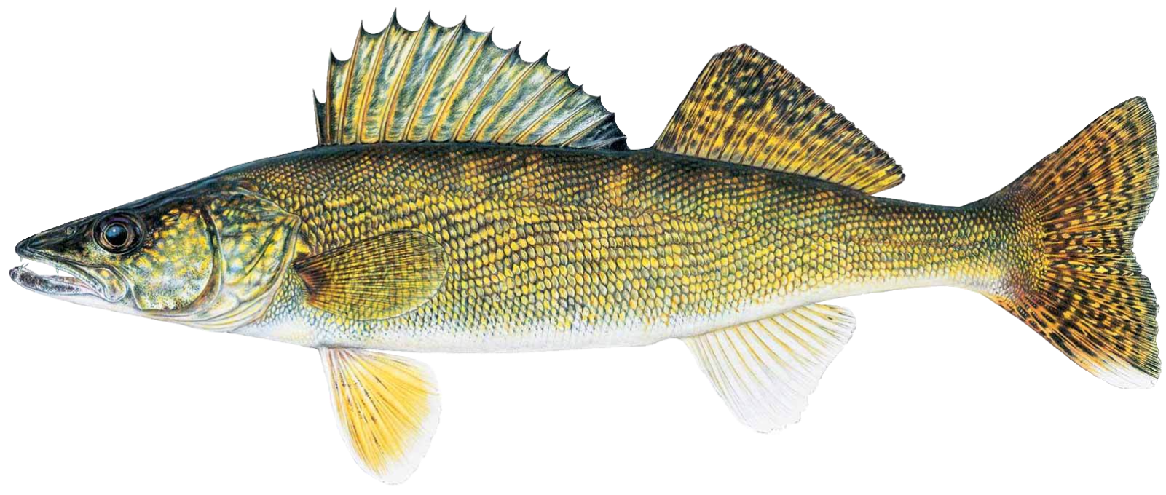
© Joseph R. Tomelleri

